Slide 1
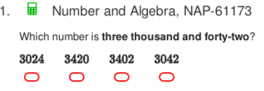
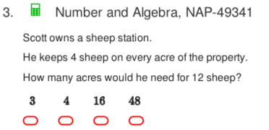
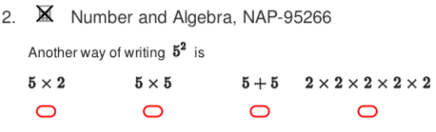
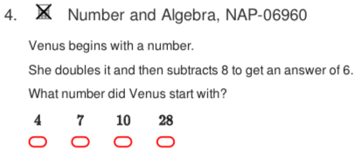
NAPLAN Starter Questions

Slide 2





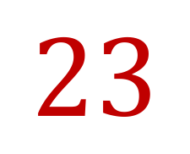

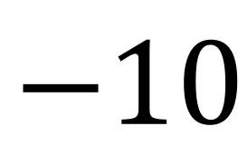
My Numbers and Operations Interactive Notebook
$$+$$
$$23$$
-1
$$−$$
$$×$$
$$÷$$
Name:
Class:
Teacher:
Semester 1
Term 1
$$5^{2}$$
$$0$$
$$−10$$

Slide 3

Interactive Notebooks!
Cover Page
Contents Page
Glossary
24/7/30
EQ
Questions
Notes
Summaries
Work page
Presentation!!!
Your book, your responsibility!

Slide 4


Slide 5
Contents
Glossary or Formula Page
Page
Date
Description
2
3

Slide 6

Learning Intentions
To learn a bit about the history of number systems✓
To further expand and solidify our mathematical vocabulary
To further learn the value of the place system
To compare, order, add and subtract integers
WICOR

Slide 7
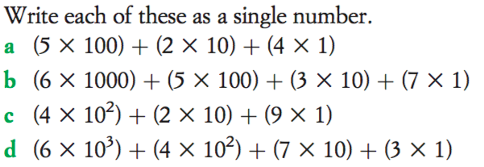
From last lesson...

Slide 8
24
7
30
Number systems
Date
EQ – What are some rules for order of operations?
You may have seen 10² and 10³ before. You’ve definitely seen symbols like + - $×$ $÷$ and numbers like 0,1,2,3,4... Before we go any further, we need some definitions.
Quickwrite: On the left hand side (LHS) of your notebook, for two minutes, I’d like you to write non-stop everything you know about numbers and mathematical symbols. Some questions to get you started:
What are all of the mathematical symbols you know?
What do you know about numbers? Are they only positive? Are they always whole, like 5 or 230...or can they look different?
***Remember, the key is to write without stopping, everything that comes into you head, for two minutes***
Summary:

Slide 9
Numbers (what do we know about them?) | Symbols (what are all the ones we know?)

Slide 10
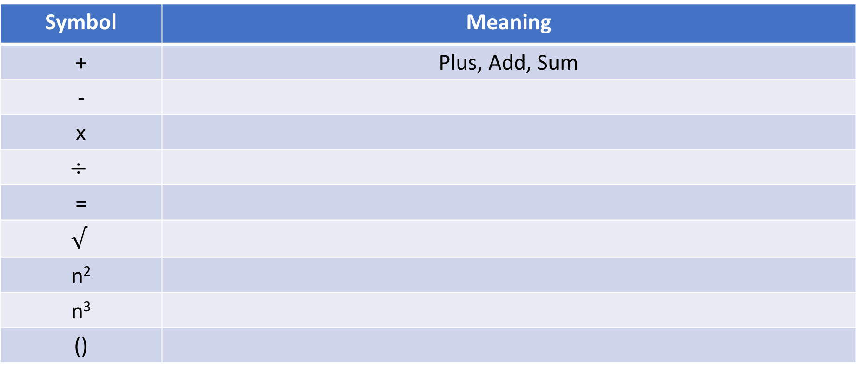
Glossary Terms
Working in pairs or a group of 3, list the following symbols in your glossary and as many meanings as you can come up with for each. Throughout the year we will add to this. You have 5 minutes, the first one is done for you. We will go over as a class after 5 minutes.
Symbol | Meaning
+ | Plus, Add, Sum
-
x
$$÷$$
=
$$√$$
n²
n³
()

Slide 11
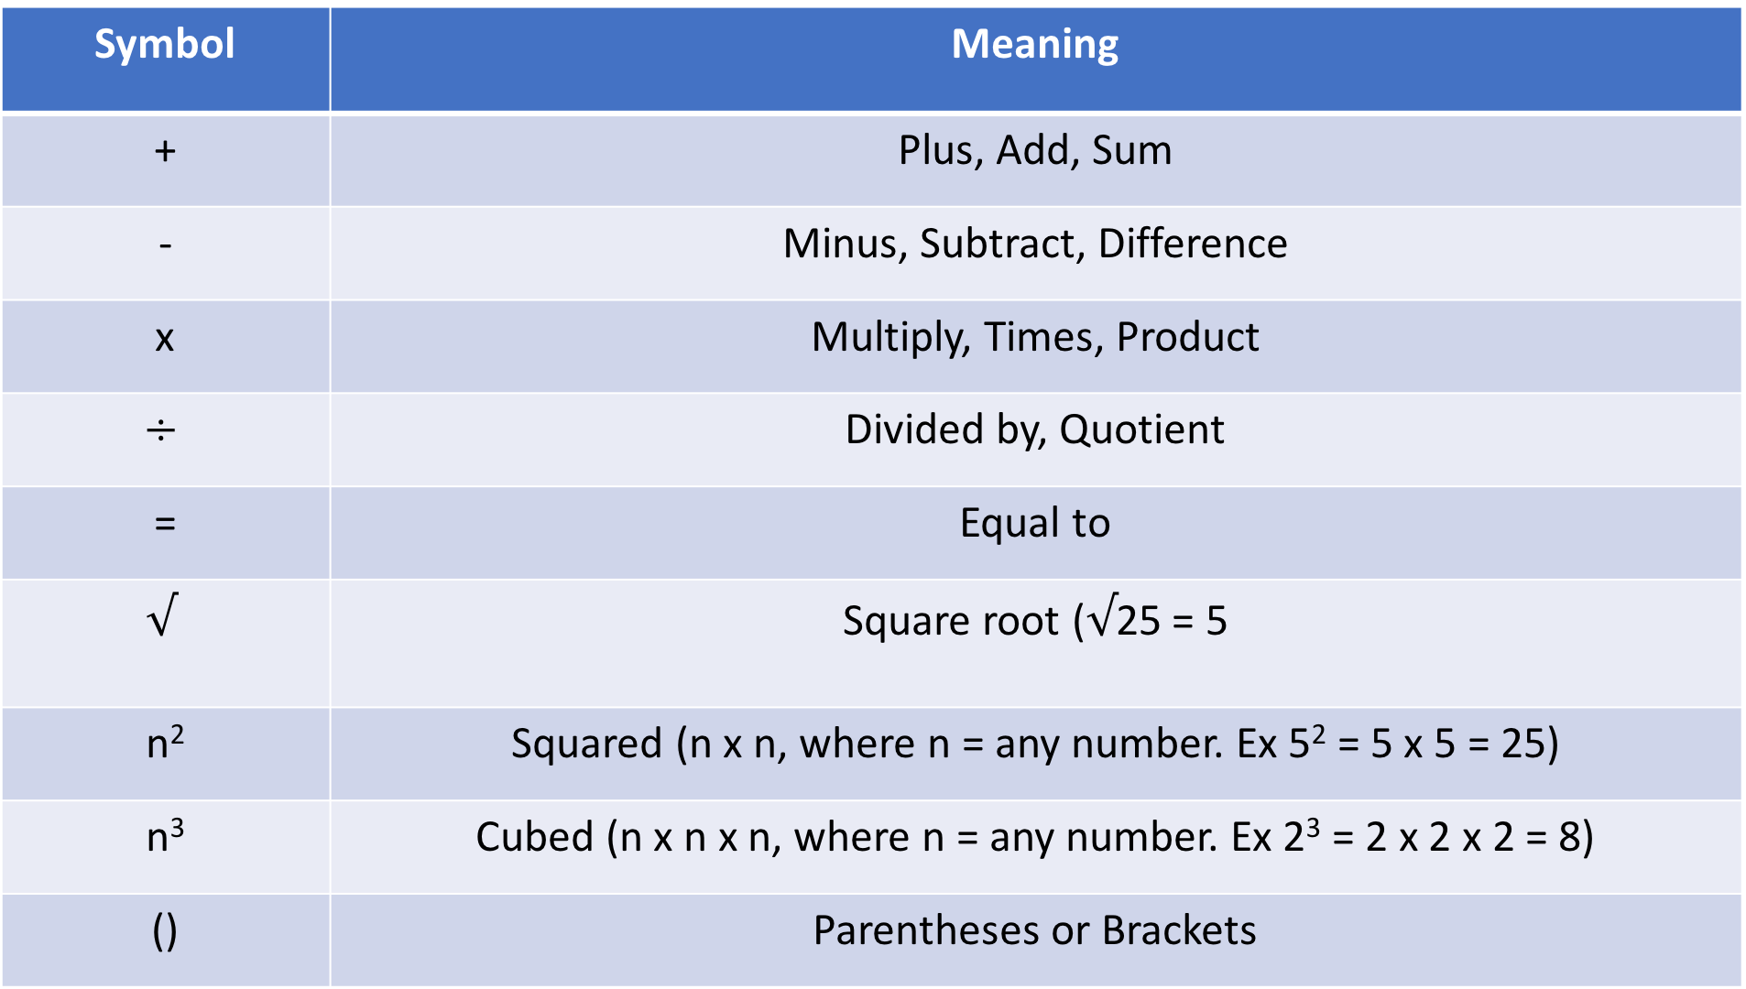
Symbol | Meaning
+ | Plus, Add, Sum
- | Minus, Subtract, Difference
x | Multiply, Times, Product
$$÷$$ | Divided by, Quotient
= | Equal to
$$√$$ | Square root ($√$25 = 5
n² | Squared (n x n, where n = any number. Ex 5² = 5 x 5 = 25)
n³ | Cubed (n x n x n, where n = any number. Ex 2³ = 2 x 2 x 2 = 8)
() | Parentheses or Brackets

Slide 12
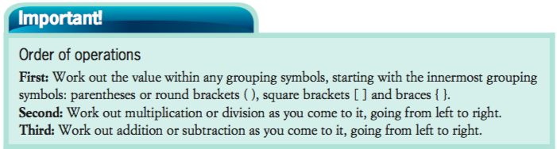
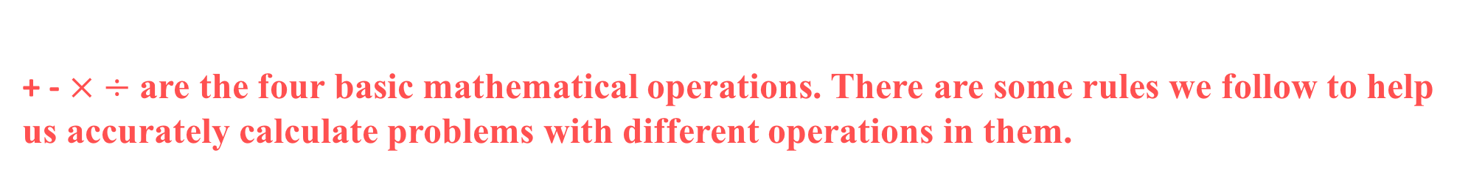
24
7
30
Number systems
Date
EQ – What are some rules for order of operations?
+ - $× ÷$ are the four basic mathematical operations. There are some rules we follow to help us accurately calculate problems with different operations in them.
Very important

Slide 13


24
7
30
Number systems
Date
EQ – What are some rules for order of operations?

Slide 14
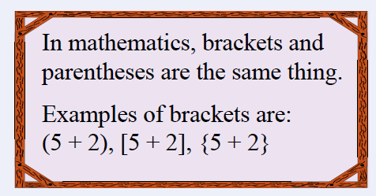
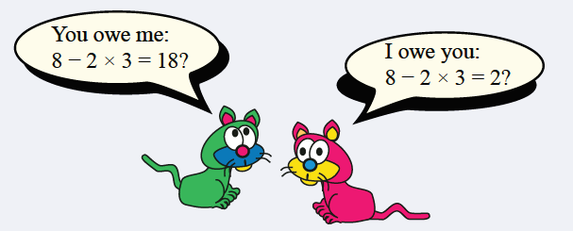
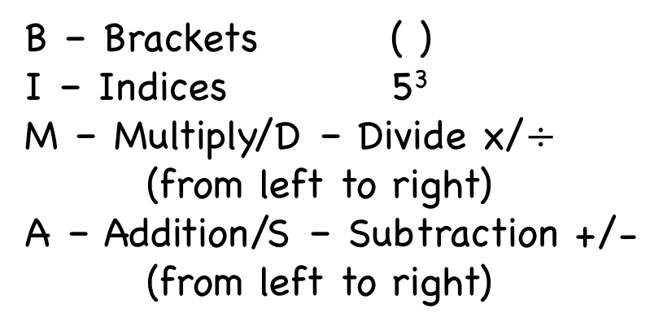
24
7
30
Number systems
Date
EQ – What are some rules for order of operations?
We can use BIMDAS to help us remember the order we use them to work out equations!
What does BIMDAS stand for?
B – Brackets ( )
I – Indices 5³
M – Multiply/D – Divide x/$÷$
(from left to right)
A – Addition/S – Subtraction +/-
(from left to right)
Which cat is correct??

Slide 15

Do you understand? Fists of Five
Notes:
Check for Understanding

Slide 16
Examples
$$\left(8−5\right)×3$$
$=3×3$
$$=$$
Notes:
• Give students the opportunity to practise with teacher guidance
• Provide immediate and specific feedback with knowledge of results

Slide 17
Examples
$$5×6−(4+2)÷3+2=5×6−6÷3+2=30−2+2$$
=
Notes:
• Give students the opportunity to practise with teacher guidance
• Provide immediate and specific feedback with knowledge of results

Slide 18
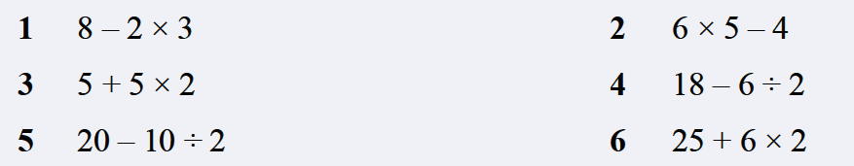

Task
A bit more difficult
Notes:
• Give students the opportunity to practise with teacher guidance
• Provide immediate and specific feedback with knowledge of results

Slide 19
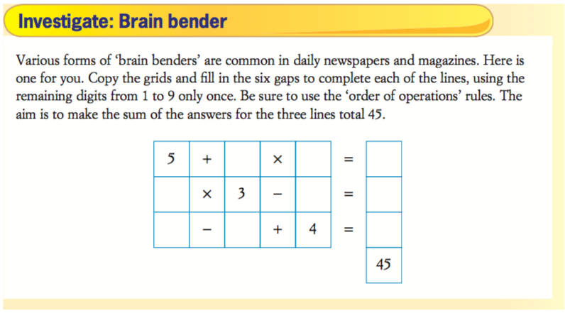
Notes:
• Give students the opportunity to practise with teacher guidance
• Provide immediate and specific feedback with knowledge of results

Slide 20
24
7
30
Number systems
Date
EQ – What are some rules for order of operations?
Complete your Summary!!!
Summary:

Slide 21
Notes Review
24, 7 ,30
Date
Title
Essential question
Notes complete
Notes complete with colour and diagrams
Questions completed
Contents page filled in
Formula page filled in

